Slide 1
Lecture 04 - Component Segmentation
Prof. André Gustavo Hochuli
gustavo.hochuli@pucpr.br
aghochuli@ppgia.pucpr.br
Notes:
Prof. André Hochuli

Slide 2
Topics
Discussion of Practice 03
Component Segmentation
Finding Connected Components
Watershed
Filtering Components
Practice
Coin Segmentation
Computer Vision - Prof. André Hochuli
Lecture 04
Notes:
Prof. André Hochuli

Slide 3
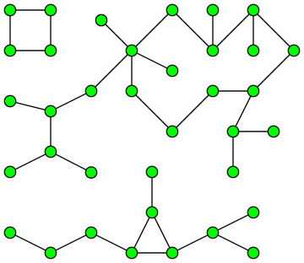
Component Segmentation
A.K.A Connected Component Extraction, Blob Extraction, …..
Its application comes from Graph Theory
Social Networks
Biology
Pattern Recognition
Computer Vision - Prof. André Hochuli
Lecture 04
Notes:
Prof. André Hochuli

Slide 4


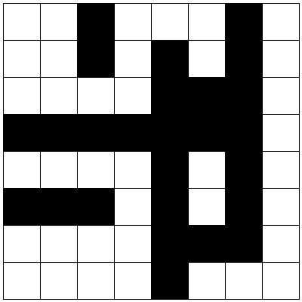
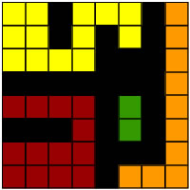
Connected Component Labelling
Analyzes the non-zero pixel's neighborhood (foreground)
Label each connected pixel with a label (1,2,3,4….)
Kernels:
4-Neighboors
8-Neighboors
Computer Vision - Prof. André Hochuli
Lecture 04
Notes:
Prof. André Hochuli

Slide 5

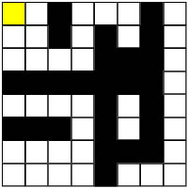
Row by Row Algorithm
Two passes
For each row:
If the center falls in a non-zero pixel, label it!
Labelling:
If there no labeled pixels connected, attribute a new label
Otherwise, attribute the label of its neighbor
Pass #1:
ROW #1
Computer Vision - Prof. André Hochuli
Lecture 04
Notes:
Prof. André Hochuli

Slide 6

Row by Row Algorithm
Two passes
For each row:
If the center falls in a non-zero pixel, label it!
Labelling:
If there no labeled pixels connected, attribute a new label
Otherwise, attribute the label of its neighbor
Pass #1:
ROW #1
Computer Vision - Prof. André Hochuli
Lecture 04
Notes:
Prof. André Hochuli

Slide 7
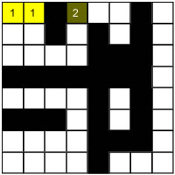
Row by Row Algorithm
Two passes
For each row:
If the center falls in a non-zero pixel, label it!
Labelling:
If there no labeled pixels connected, attribute a new label
Otherwise, attribute the label of its neighbor
Pass #1:
ROW #1
Computer Vision - Prof. André Hochuli
Lecture 04
Notes:
Prof. André Hochuli

Slide 8
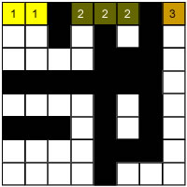
Row by Row Algorithm
Two passes
For each row:
If the center falls in a non-zero pixel, label it!
Labelling:
If there no labeled pixels connected, attribute a new label
Otherwise, attribute the label of its neighbor
Pass #1:
ROW #1
Computer Vision - Prof. André Hochuli
Lecture 04
Notes:
Prof. André Hochuli

Slide 9
Row by Row Algorithm
Sliding a connectivity kernel , row by row ( 2 passes)
If the center falls in a non-zero pixel, label it!
Labelling:
If there no labeled pixels connected, attribute a new label
Otherwise, attribute the label of its neighbor
Union-Find structures determines the labels connected
Pass #1:
ROW #1
Computer Vision - Prof. André Hochuli
Lecture 04
Notes:
Prof. André Hochuli

Slide 10
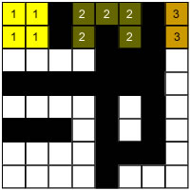
Row by Row Algorithm
Sliding a connectivity kernel , row by row ( 2 passes)
If the center falls in a non-zero pixel, label it!
Labelling:
If there no labeled pixels connected, attribute a new label
Otherwise, attribute the label of its neighbor
Union-Find structures determines the labels connected
Pass #1:
ROW #2
Computer Vision - Prof. André Hochuli
Lecture 04
Notes:
Prof. André Hochuli

Slide 11
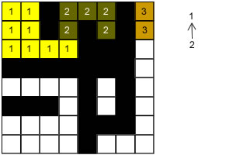
Row by Row Algorithm
Sliding a connectivity kernel , row by row ( 2 passes)
If the center falls in a non-zero pixel, label it!
Labelling:
If there no labeled pixels connected, attribute a new label
Otherwise, attribute the label of its neighbor
Union-Find structures determines the labels connected
Pass #1:
ROW #3
Union-Find
Computer Vision - Prof. André Hochuli
Lecture 04
Notes:
Prof. André Hochuli

Slide 12
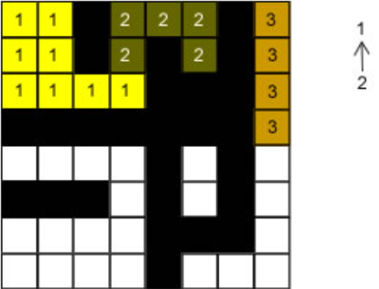
Row by Row Algorithm
Sliding a connectivity kernel , row by row ( 2 passes)
If the center falls in a non-zero pixel, label it!
Labelling:
If there no labeled pixels connected, attribute a new label
Otherwise, attribute the label of its neighbor
Union-Find structures determines the labels connected
Pass #1:
ROW #4
Union-Find
Computer Vision - Prof. André Hochuli
Lecture 04
Notes:
Prof. André Hochuli

Slide 13
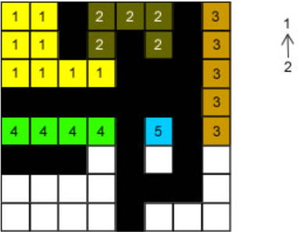
Row by Row Algorithm
Sliding a connectivity kernel , row by row ( 2 passes)
If the center falls in a non-zero pixel, label it!
Labelling:
If there no labeled pixels connected, attribute a new label
Otherwise, attribute the label of its neighbor
Union-Find structures determines the labels connected
Pass #1:
ROW #5
Union-Find
Computer Vision - Prof. André Hochuli
Lecture 04
Notes:
Prof. André Hochuli

Slide 14
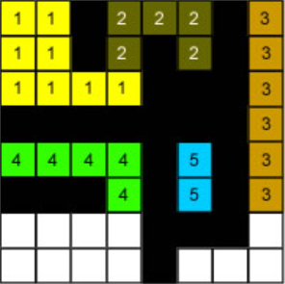
Row by Row Algorithm
Sliding a connectivity kernel , row by row ( 2 passes)
If the center falls in a non-zero pixel, label it!
Labelling:
If there no labeled pixels connected, attribute a new label
Otherwise, attribute the label of its neighbor
Union-Find structures determines the labels connected
Pass #1:
ROW #6
Union-Find
Computer Vision - Prof. André Hochuli
Lecture 04
Notes:
Prof. André Hochuli

Slide 15
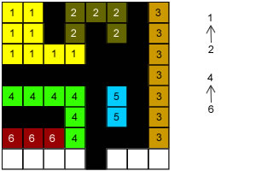
Row by Row Algorithm
Sliding a connectivity kernel , row by row ( 2 passes)
If the center falls in a non-zero pixel, label it!
Labelling:
If there no labeled pixels connected, attribute a new label
Otherwise, attribute the label of its neighbor
Union-Find structures determines the labels connected
Pass #1:
ROW #7
Union-Find
Computer Vision - Prof. André Hochuli
Lecture 04
Notes:
Prof. André Hochuli

Slide 16
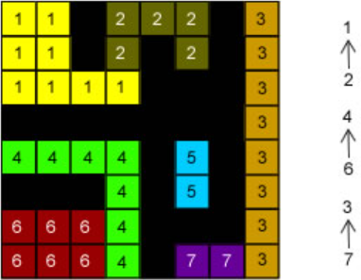
Row by Row Algorithm
Sliding a connectivity kernel , row by row ( 2 passes)
If the center falls in a non-zero pixel, label it!
Labelling:
If there no labeled pixels connected, attribute a new label
Otherwise, attribute the label of its neighbor
Union-Find structures determines the labels connected
Pass #1:
ROW #8
Union-Find
Computer Vision - Prof. André Hochuli
Lecture 04
Notes:
Prof. André Hochuli

Slide 17
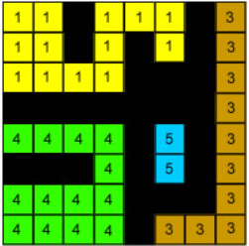
Row by Row Algorithm
Sliding a connectivity kernel , row by row ( 2 passes)
If the center falls in a non-zero pixel, label it!
Labelling:
If there no labeled pixels connected, attribute a new label
Otherwise, attribute the label of its neighbor
Union-Find structures determines the labels connected
Pass #2:
Resolve Union-Find
Union-Find
Computer Vision - Prof. André Hochuli
Lecture 04
Notes:
Prof. André Hochuli

Slide 18
Let’s Code!
In the opencv lib, this feature is implemented by cv2.connectedComponents
Computer Vision - Prof. André Hochuli
Lecture 04
Notes:
Prof. André Hochuli

